Slide 1

Unit 6:Distributed Memory Architecture.
Point 2–Tightly Coupled Architecture.
Dr. Mrs Mamata Sachin Kalas
Email id:kalas.mamta@kitcoek.in

Slide 2

Tightly coupled Multiprocessor
 A multiprocessor is a tightly coupled computer
system having two or more processing units
(Multiple Processors) each sharing main memory
and peripherals, in order to simultaneously process
Programs.
 Tightly coupled Multiprocessor is also known as
shared memory system.
4/24/2020
Tightly Coupled Multiprocessors
4/17/2012

Slide 3
Tightly coupled architecture
The throughput of the hierarchical loosely coupled multiprocessor may be too slow for some applications that require fast response times. If high speed or real time processing is required the TCS may be used. Two typical models are used.
In the first model, it consists of-
p processors
l memory modules
d input-output channels
The above units are connected through a set of three interconnection networks namely the
processor-memory interconnection network (PMIN)
I/O processor interconnection network (IOPIN)
Interrupt Signal Interconnection Network (ISIN)
4/24/2020
Tightly Coupled Multiprocessors

Slide 4
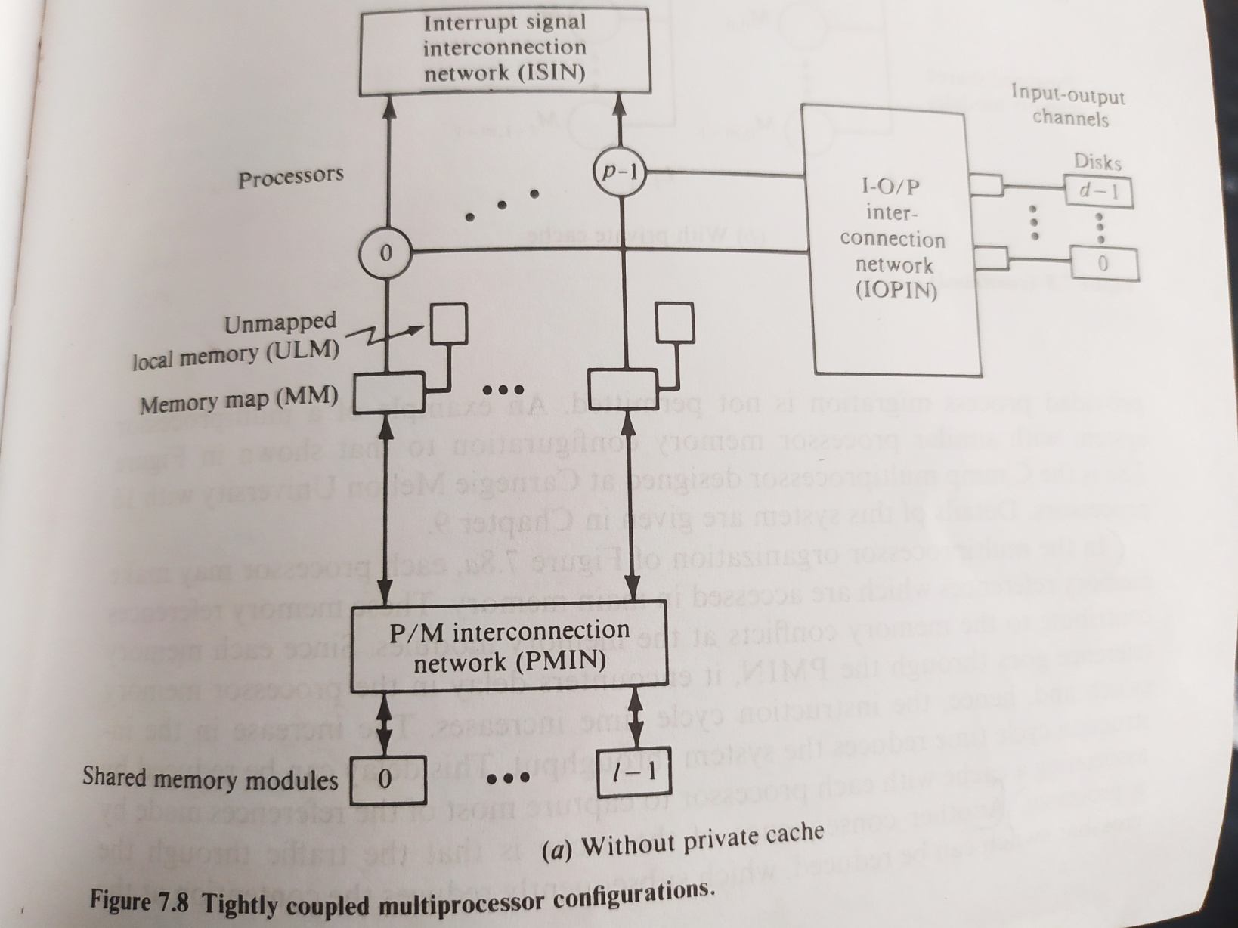
TCS-Configuration I
4/24/2020
Tightly Coupled Multiprocessors

Slide 5
TCS- Configuration I
The PMIN is a switch which can connect every processor to every module. It has pl set of cross points. It is a multistage network. A memory can satisfy only one processor’s request in a given memory cycle.
Hence if more than one processors attempt to access the same memory module, a conflict occurs and it is resolved by the PMIN.
Another method to resolve the conflict is to associate a reserved storage area with each processor and it is called as ULM (unmapped local memory). It helps in reducing the traffic in PMIN.
Since each memory references goes through the PMIN, it encounters delay in the processors memory switch so this can be overcome by using a private cache with each processor.
4/24/2020
Tightly Coupled Multiprocessors

Slide 6
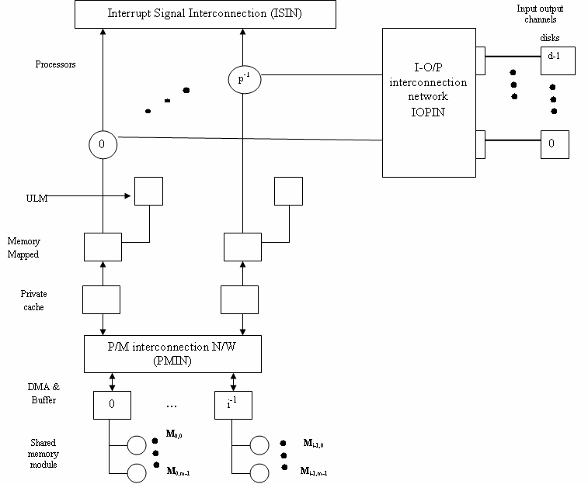
TCS – configuration II
4/24/2020
Tightly Coupled Multiprocessors

Slide 7
TCS – Configuration II
Multiprocessor organization with cache encounters the cache coherence problem. More than one consistent copy of data may exist in the system.
In the figure there is a module attached to each processor that directs the memory reference to either the ULM or the private cache of that processor. This module is called the memory map and is similar in operation to the Slocal.
4/24/2020
Tightly Coupled Multiprocessors

Slide 8
Processor characteristics for multiprocessing
Process Recoverability :
In case of faulty processors, all the suspended processes of the faulty processor must be available to other working processors. Can be implemented using shared general purpose register file.
Efficient context switching :
A special instruction like central exchange jump in Cyber -170 can be used for it.
Instr. has single set of registers. saves current state of process and replace register set by state of another ready process from central memory(exchange package).
Another way is to use multiple register set, along with current process register in the processor pointing to state of running process.
4/24/2020
Tightly Coupled Multiprocessors

Slide 9
Processor characteristics for multiprocessing
3.Large virtual and physical address space :Processors used in multiprocessors must support large physical space.
When an algorithm is implemented using small amounts of code,processes need to access large amounts of data objects.
16 bit address space of processor used in C.mmp hampered effective programming of objects.
In addition,large virtual address needed, and it should be segmented to promote modular sharing and checking of address bounds for memory protection and software reliability.
4. Effective synchronization primitives
4/24/2020
Tightly Coupled Multiprocessors

Slide 10
Processor characteristics for multiprocessing
4.Effective synchronization primitives:
Processor design must provide synchronization primitives
These synchronization primitives require efficient mechanism for implantation of mutual exclusion.
Mutual exclusion required when two or more processes executes concurrently and must operate to exchange data during computation.
4/24/2020
Tightly Coupled Multiprocessors

Slide 11
Processor characteristics for multiprocessing
5.Interprocessor communication mechanism:
Set of processors must provide efficient means of inter processor communication.
Hardware interprocess mechanism used to facilitate synchronization between processor.
6. Instruction set:
Should have adequate facilities for implementing HLL that permit effective concurrency at procedure level and efficiently manipulating data structures.
Instruction should be provided for procedure linkage, looping constructs, multidimensional index computation and rank checking of addresses.
4/24/2020
Tightly Coupled Multiprocessors

